Slide 1

CSC 1004: Tutorial 11
Project Implementation (2)
Guanren Qiao
SDS, CUHK-SZ

Slide 2
Recap
class SnakeGame(tk.Tk):
def __init__(self):
super().__init__()
self.title("Snake Game")
self.geometry("800x800")
self.resizable(False, False)
self.width = 800
self.height = 800
self.cell_size = 20
self.snake_direction = 'Right'
self.snake = [(100, 100), (80, 100), (60, 100)]
self.food = self.create_food()
self.game_frame = tk.Frame(self)
self.canvas = tk.Canvas(self.game_frame, bg='black', width=self.width, height=self.height)
self.start_game()
def setup_ui(self):
self.update_ui()
self.bind("<KeyPress>", self.change_direction)

Slide 3
update_ui
def update_ui(self):
self.canvas.delete('all')
for x, y in self.snake:
self.canvas.create_rectangle(x, y, x + self.cell_size, y + self.cell_size, fill='green')
the update of food state is the same as the snake, and you can finish it by yourself.

Slide 4
change_direction
def change_direction(self, event):
opposite_directions = {'Left': 'Right', 'Right': 'Left', 'Up': 'Down', 'Down': 'Up'}
if event.keysym in ['Left', 'Right', 'Up', 'Down']:
# Check if the new direction is opposite to the current direction
if event.keysym != opposite_directions[self.snake_direction]:
self.snake_direction = event.keysym
remember to use bind function to connect change_direction function (see Tutorial 10)

Slide 5
move_snake
def move_snake(self):
head_x, head_y = self.snake[0]
if self.snake_direction == 'Left':
head_x -= self.cell_size
elif self.snake_direction == 'Right':
head_x += self.cell_size
elif self.snake_direction == 'Up':
head_y -= self.cell_size
elif self.snake_direction == 'Down':
head_y += self.cell_size
new_head = (head_x, head_y)
self.snake = [new_head] + self.snake[:-1]
self.update_ui()
You should also consider the timestep of eatting food and collision in this function.

Slide 6
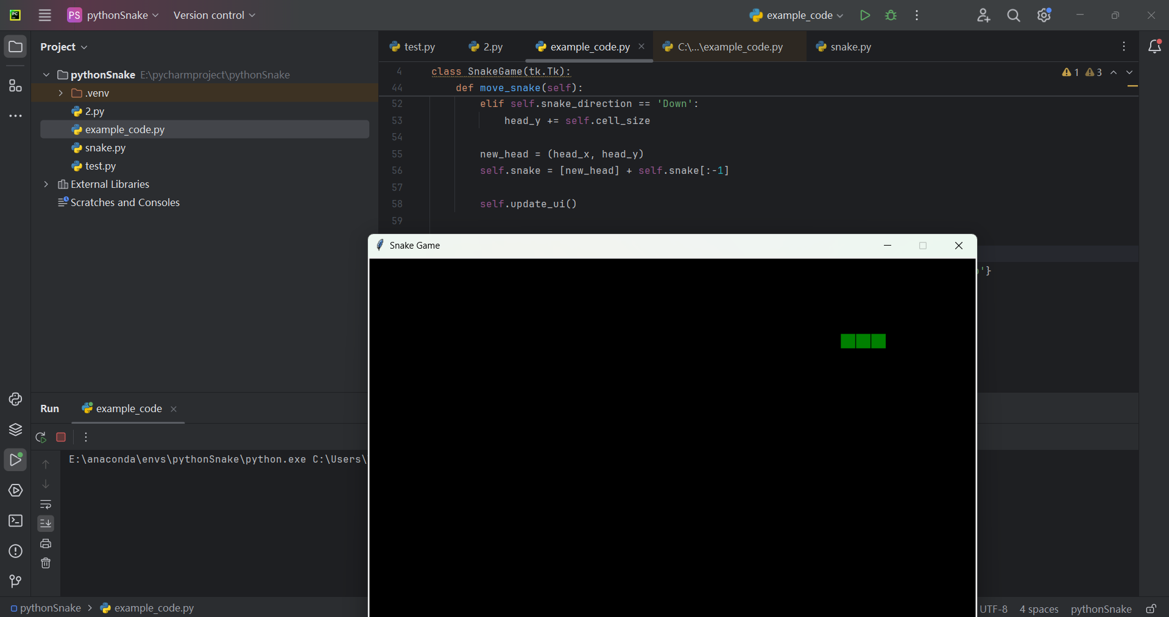
Run example code
download the example code in bb and place it in your folder.
click file and open this py file.
configure conda environment or virual environment
configure run/debug setting to run this code.

